Slide 1
EU – BANGLADESH Talent Partnership Program: Launched of a New path to Boost Labour Mobility
Date: January 15, 2025
Presented by: ITALBANGLA ASSOCIATION & PROMISE AGENCIS LTD

Slide 2
Europe’s Labour Market Recovery and Ongoing Concerns
Europe’s labour market is recovering from COVID’s effects, but there are still challenges.
The latest statistics show a decrease in job vacancy rate and
increase in employment:
Job Vacancy Rate: Decreased from 2.8% (Q1) to 2.7% (Q2).
Employment rate (ages 20-64): Increased to 75.4%, up by 0.1
percentage points.
Ongoing concerns:
Despite recovery, Europe still faces a wider labor shortage,
making it hard to meet market demands.

Slide 3
Europe’s Economic Indicators and Labor Market Dynamics
Statistics
GDP | $19.403 trillion (nominal; 2024) $28.044 trillion (PPP; 2024)
GDP growth | 0.6% (2023) 1.1% ( 2024f ) 1.6% ( 2025f )
GDP per capita | $43,194 (nominal; 2024) $62,660 (PPP; 2024)
GDP by sector | Agriculture: 1.7% Industry: 23.7% Services: 65% (2023 est. )

Slide 4
Europe’s Economic Indicators and Labor Market Dynamics
1. EU GDP and Economy: The European Union's GDP has shown resilience, with real GDP growth stabilizing post-COVID. After a 5.6% contraction in 2020, growth rebounded with 6.0% in 2021, 3.4% in 2022, and a slight increase of 0.5% in 2023. Germany, the largest economy within the EU, has been experiencing labor shortages in key sectors, impacting its growth potential and causing ripple effects across the EU’s interconnected economies.
2. Population and Workforce: The EU population is aging rapidly, with predictions that over 25% of residents will be over retirement age by 2030. This demographic shift underscores the urgency to bolster workforce numbers through skilled migration and labor policies.
3. Labor and Skill Shortages: The EU faces acute shortages in several sectors, including Healthcare, Textile, Construction, Transport, Tourism, Agriculture, Manufacturing Industries and ITC. Germany, Italy, Neatherland for example, reports critical shortages in these fields, which contribute to a broader labor gap that hampers the region’s economic competitiveness.

Slide 5
Europe’s Economic Indicators and Labor Market Dynamics
4. Current Labor Market: The EU’s job vacancy rate, while slightly declining in 2024, remains indicative of unmet demand for skilled workers. The labor market’s tightness also shows in high vacancy rates in essential sectors, illustrating a demand that European education and training systems struggle to meet effectively.
5. Immigration and Labor Policies: Migrant workers currently make up a significant portion of Europe’s workforce. The Talent Partnership programs aim to enhance these pathways, providing structured, safe migration opportunities to fill specific gaps in the labor market. This program also emphasizes skill matching and training to integrate migrant workers effectively into the EU’s economy.

Slide 6
Introduction of TP :
On July 8, 2024, the European Commission launched a new programme under the Talent Partnership with Bangladesh.
Objective: Boost labour mobility and enhance cooperation on migration.

Slide 7
Programme Overview
Name: Supporting a Talent Partnership with Bangladesh
Budget: EUR 3 million
Implementing Agency: International Labour Organisation (ILO)
Focus Areas:
Skills development
Labour market trends
Regular and safe migration pathways to the EU

Slide 8
Objectives of the Programme
Facilitate legal labour migration from Bangladesh to the EU.
Combat irregular migration by providing safe, regular pathways.
Address training needs in sectors beneficial to both Bangladesh and the EU.

Slide 9
Key Components
Information Access: Enhanced access to labour market information.
Training Support:
Vocational and professional training.
Language and soft skills training.
Skills Recognition: Facilitate the validation of skills.

Slide 10
Stakeholder Engagement
Strengthen collaboration among Bangladeshi legal migration stakeholders:
Government agencies
Private sector
Civil society organizations

Slide 11
Transforming “Brain Drain” to “Brain Gain”
Focus on building a strategic framework for sustainable cooperation.
Identify common needs and joint actions between the EU and Bangladesh.

Slide 12
Background Context
June 2021: Launch of Talent Partnerships to address skill shortages in the EU.
Current Partnerships: In addition to Bangladesh, with Egypt, Morocco, Pakistan, and Tunisia.

Slide 13
Comprehensive Policy Framework
Talent Partnerships aim to:
Provide funding support for migration
management.
Enhance legal pathways for skilled individuals.
Contribute to the Global Alliance to Counter
Migrant Smuggling.

Slide 14
Implementation Timeline
Programme Duration: July 2024 - June 2027.
Mobility Schemes: Between Bangladesh and participating EU Member States.
Monitoring: Scheduled review at the third Talent Partnership Roundtable in early 2025.

Slide 15
Supporting Pilot Projects
Learning from Pilot Projects: Builds on ILO's Skills 21 project.
Aim: Training and facilitating safe mobility for 3,000 skilled migrant workers.

Slide 16
Achievement of Italbangla Assocaition
As Leading Italian-Bangladeshi partnership Experience of Italian Pre Departure Language Professional, Custom Security and Training Program.
Focusing on Increasing Demand of Labor necessity of Legal safe Migration Process.
Development of Language Training Facility and Certification for Italian Language.
Creation of Joint venture among the Bangladesh Government, Private Operator and Professional Training Facility
Successfully operating two Italian MLPS APPROVED overseas training program :
Bangla dream.
Bangla lux.

Slide 18
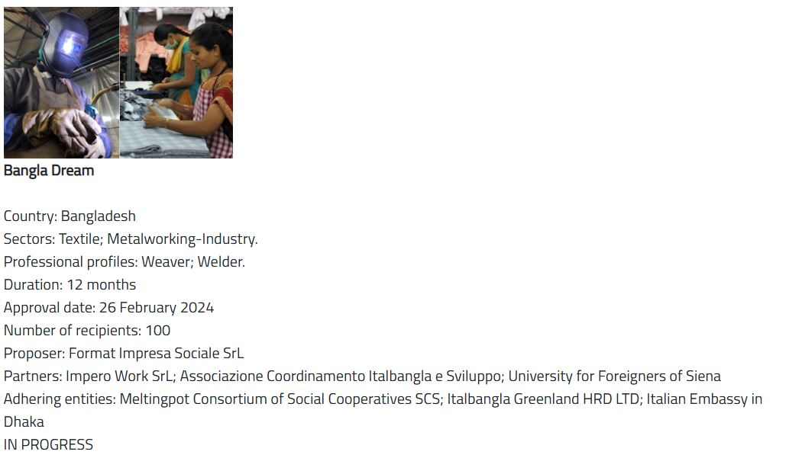
Introduction of Bangla Dream

Slide 19
Introduction of Bangla Lux

Slide 20
How Talent Partnerships Work
Mobility Support for:
Study.
Work.
Training in the EU.
Capacity Building Assistance:
Skills intelligence.
Vocational education and training.
Integration of returning migrants.

Slide 21
Strategic Engagement
Establish balanced and comprehensive partnerships with non-EU states.
Engage strategically on migration management and mutual benefits.

Slide 22
Conclusion
The Talent Partnership with Bangladesh represents a significant step towards enhancing legal migration pathways.
Highlights commitment to addressing labour market needs while ensuring safe migration for skilled professionals.
And we Italbangla are very much happy to participate in this process and share our expertise.

Slide 23
Questions and Discussion
Open floor for questions and insights from attendee.
THANK YOU

